Slide 1
Value-Added Products

Slide 2
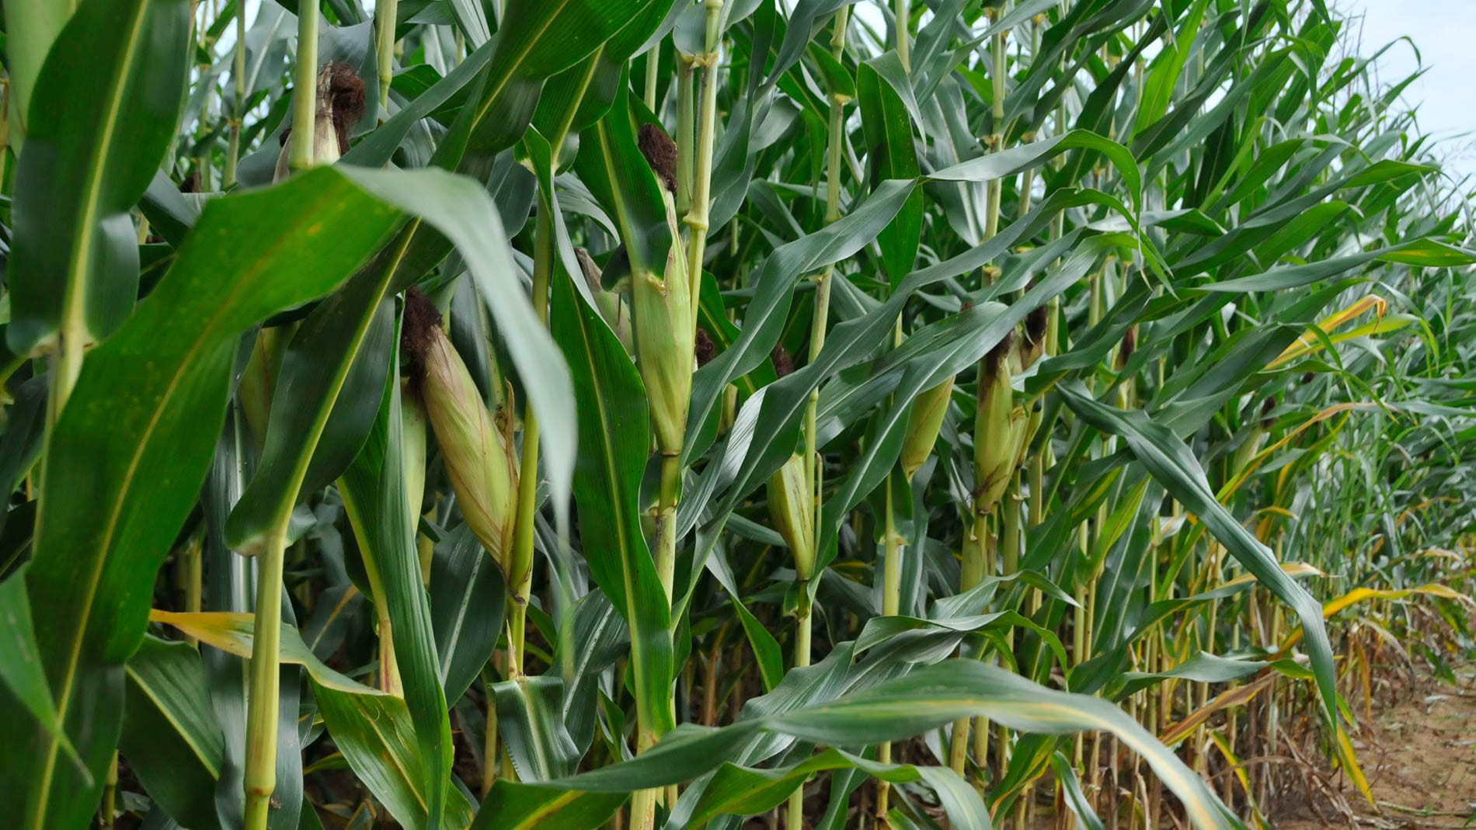
Field Corn - No

Slide 3
Wheat - No

Slide 4
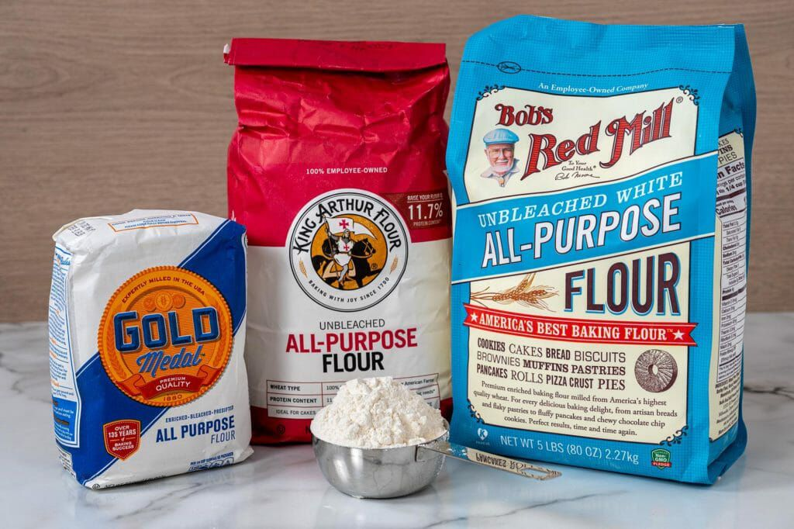
Flour - Yes

Slide 5
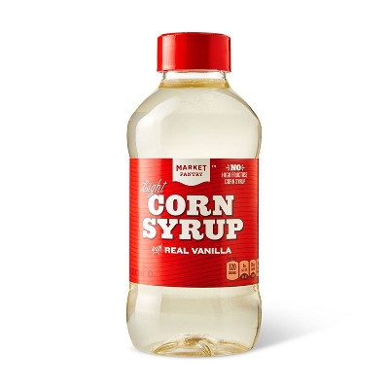
Corn Syrup - Yes

Slide 6
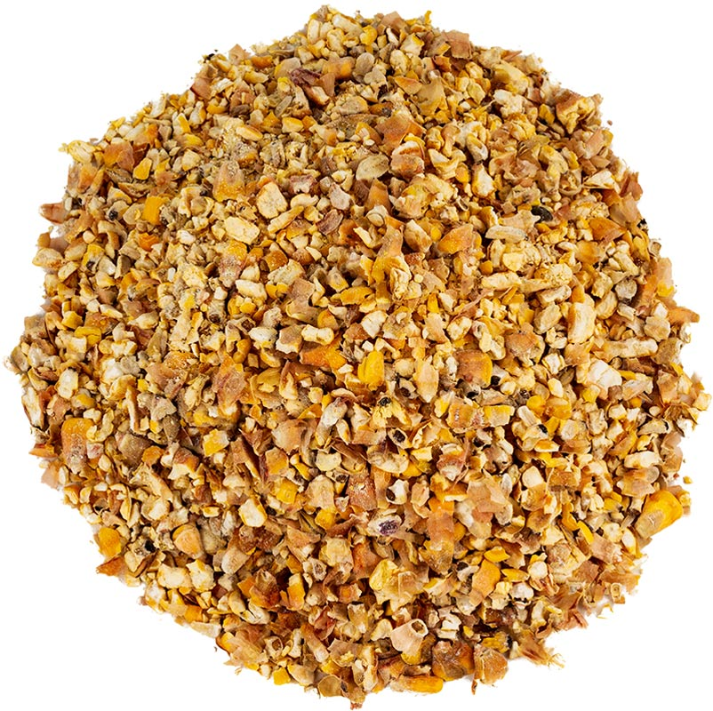
Cracked Corn Feed - Yes

Slide 7
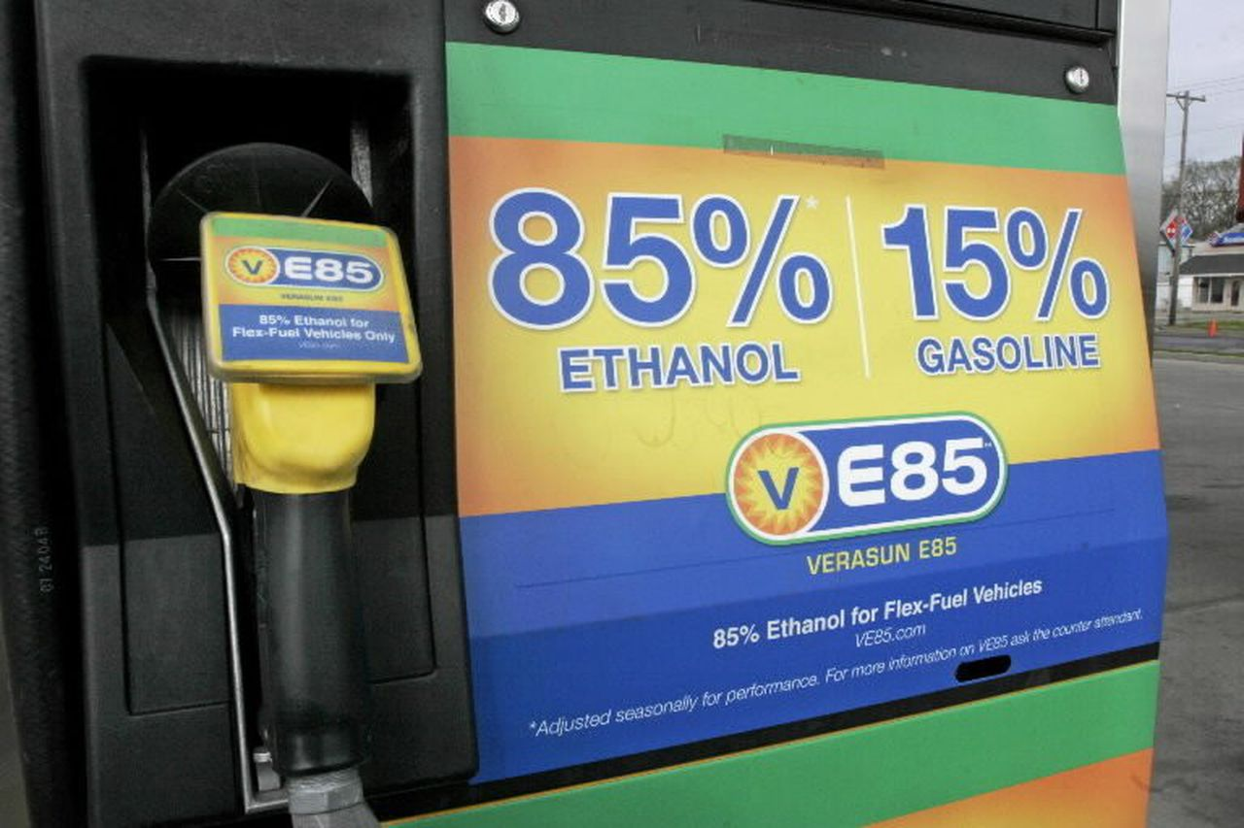
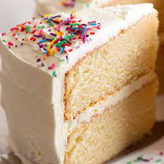
Ethanol - Yes

Slide 8
Value Added
Value added is a change in the physical state or form of the product (such as milling wheat into flour or making strawberries into jam).
The production of a product in a manner that enhances its value.

