Slide 1
Other Grains: Corn, Sorghum, Rice, Soy

Slide 2
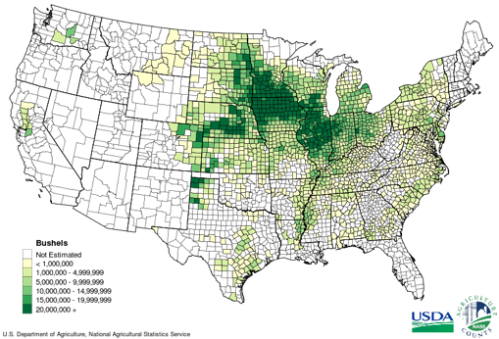
Corn
Sweet, dent, pop, waxy, flint, etc.
Yellow dent most commonly used in grain industry
Number one most widely grown grain
Plant is 8 ft tall
Most has 1 ear/stock
Approximately 600 kernels/ear
Notes:
Department of Grain Science and Industry

Slide 3
Corn kernel
Notes:
Department of Grain Science and Industry

Slide 4
Types of Corn Milling
Masa Production – Tortillas
Dry Milling – Food
kernels are hammer milled into a medium-to-fine grind meal
Wet Milling – Feed, HFCS and Ethanol
the process begins with the corn kernels being soaked in large tanks called steep tanks in a dilute aqueous sulfur dioxide solution. The softened kernel is then processed to remove the germ which is further processed to remove the high-value corn oil. The Germ Meal remaining after the oil is extracted and marketed for animal feed use.
Notes:
https://blog.amg-eng.com/corn-wet-milling-vs-dry-milling/
Department of Grain Science and Industry
https://www.youtube.com/watch?v=NgSL_CvX9cQ

Slide 5
Objects of Corn Milling
Maximum production of clean grits, with minimum fat content and specks (colored impurities from the black root cap)
Maximum recovery of the remaining endosperm as meal, with minimum flour
Maximum recovery of clean germ
Optimum blending of products to maximize profit

Slide 6
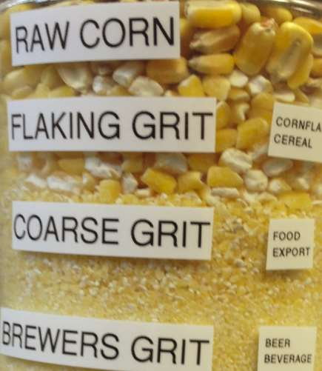
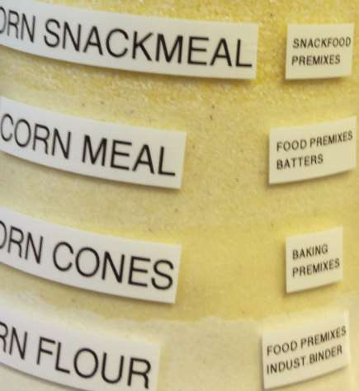
Corn Milling Products
Raw corn
Flaking Grit
Coarse Grit
Brewers Grit
Corn Snackmeal
Corn meal
Corn cones
Corn flour

Slide 7
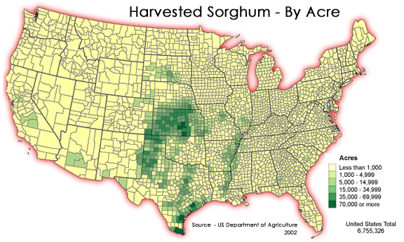
Sorghum
Also known as milo
Sorghum bicolor most commonly used in grain industry
Central peduncle holding seeds
Notes:
Department of Grain Science and Industry
Excellent drought tolerance
Various colors affected by pericarp color, pericarp thickness, endosperm color
GMO-free
Gluten-free

Slide 8
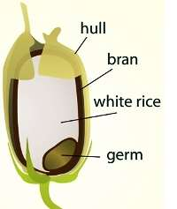
Rice
Paddy – Whole rice kernel with hull still intact
Brown Rice – Rice kernel with hull removed and bran still intact
Milled Rice (White Rice) – Hull and bran layer removed
Polished Rice – White rice that has went through polishing step
Head Rice – Unbroken grains of milled rice with hull, bran, and germ removed
Notes:
Department of Grain Sciences and Industry

Slide 9
Milling Rice
Cleaning removes foreign material.
Hull removal(Shelling)–Rubs excess husks or hulls off the clean paddy
Accomplished using a Rubber Roll Sheller
Brown rice is separated from the hull through aspiration.
Paddy separators remove paddy from brown rice
Notes:
Rice ~ 70%-75% – cooking, flaked, puffed, breakfast cereals, baby foods, noodles, rice cakes, beer Rice Husk ~ 20% - Bedding materials, fuel source, animal feed ( if ground) Rice Bran ~ 5%-10% - Animal feeds, bran oil
https://www.youtube.com/watch?v=pIaxP-t_eu8

Slide 10
Oats
Oat – Oat still containing a hull / unprocessed
Groat – Oat with hull removed
Green Groat – Groat that hasn’t been kilned

Slide 11
Oat Milling Process
Cleaning
Oats are cut into wind rows to dry like hay. Harvesters pick the oats off the ground which increases contamination.
Hulling and Roughing
Produces the groat.
Provide clean groats to the Kilning Process. Remove hulls from groats. Remove un-hulled oats from groats.
Kilning and Grading
Processing
Cutting and Flaking
Grinding into Flour

Slide 12
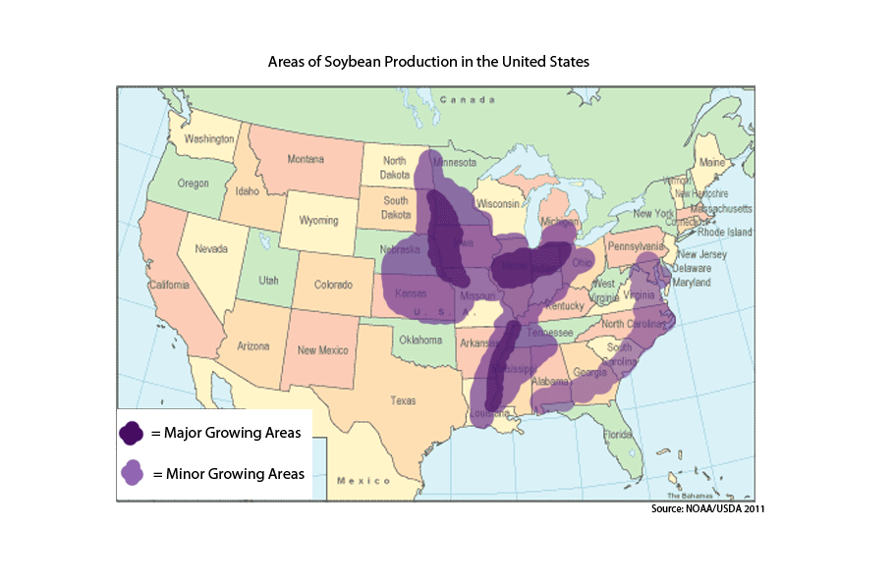
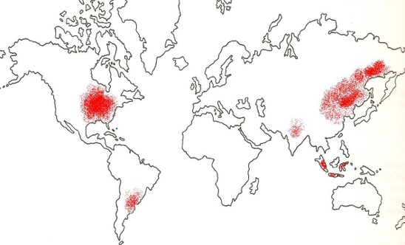
Oilseeds
Soybean
Rapeseed
Cottonseed
Peanut
Sunflower
Palm Kernel
Copra

Slide 13
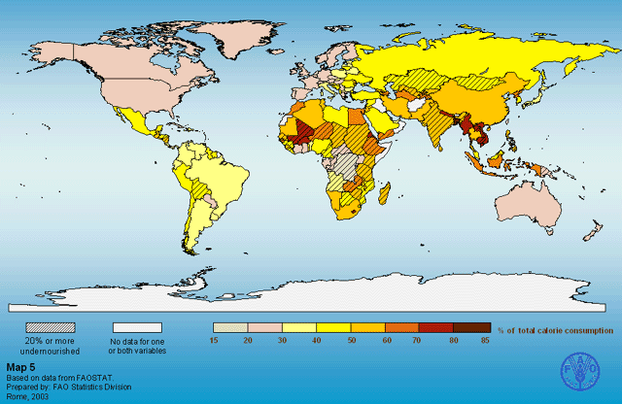
Global Cereal Grain Consumption

Slide 14
Global Cereal Grain & Oilseed Production

