Slide 1
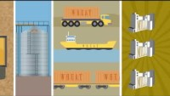
Wheat Milling
How Flour is Made – Brief Overview

Slide 2
Grind and sift, grind and sift, grind and sift, grind and sift
Breaker (rollers) → Purification (sift) → Reduction (Sift)
Repeat!
Notes:
Rollers grind wheat by rolling toward each other to break the kernel and separate the endosperm from the bran.
After being grinded, particles drop into hopper and are conveyed pneumatically to sifter.
The larger, course particles, called middlings, are sent back to the mill to repeat the process of removing more bran from the endosperm. The sizings which are finer particles that are separated in the sifting process are sent in another direction.
Wheat goes through four break rolls to remove endosperm from bran.

Slide 3
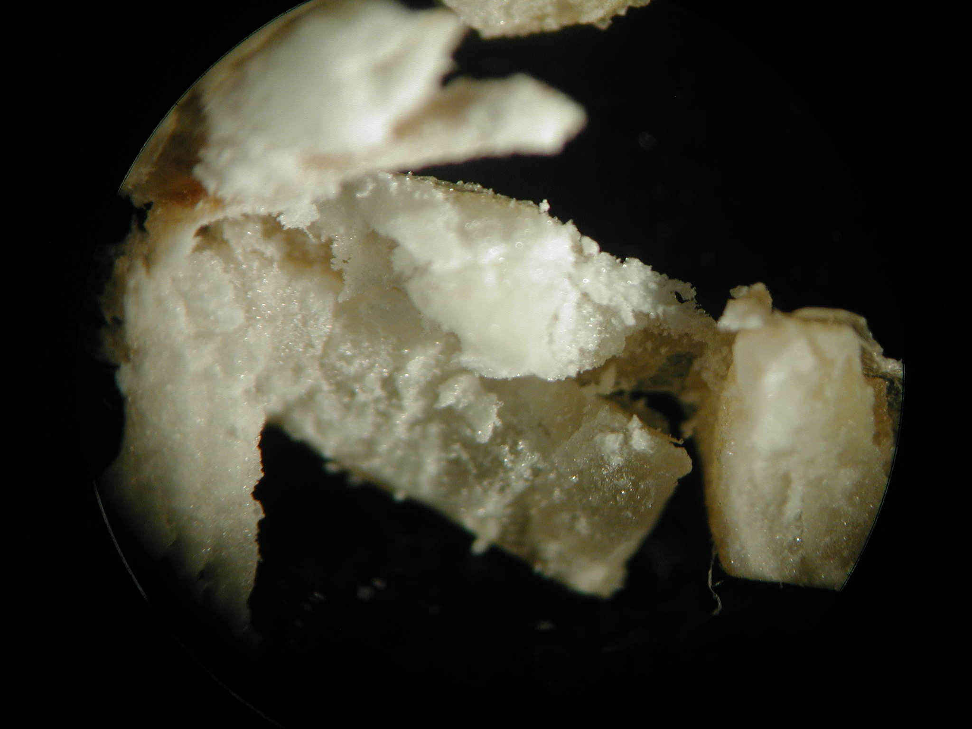
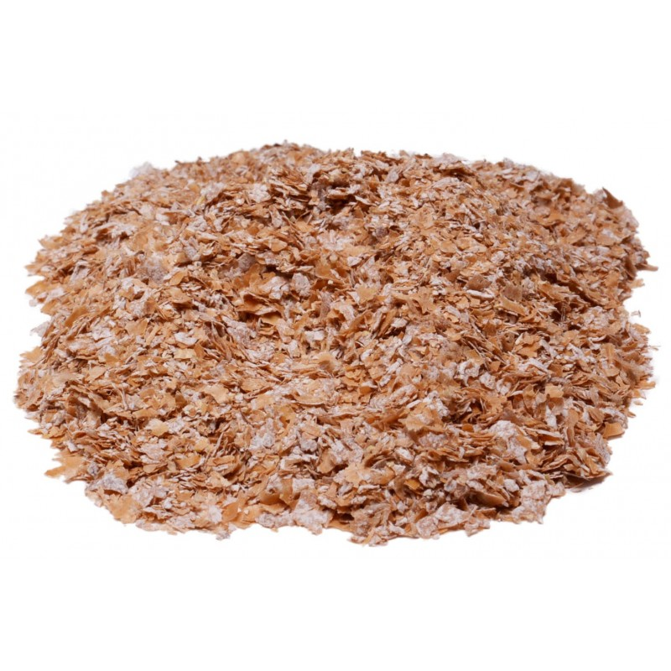
Break System (Grind)
The following occurs in a roller mill:
opens the wheat kernel
scrapes the endosperm from the bran
keeps the bran in as large of pieces as possible, keeping small bran pieces and bran powder to a minimum.
Wheat kernel during this process.
Wheat bran that has been separated from the endosperm.

Slide 4
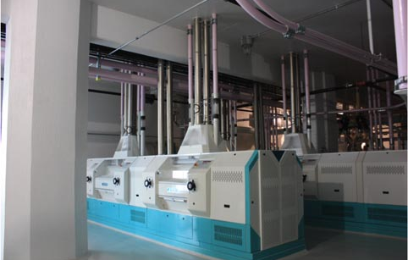
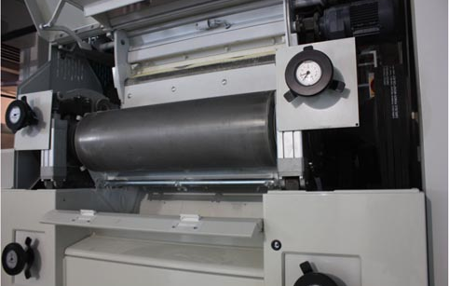
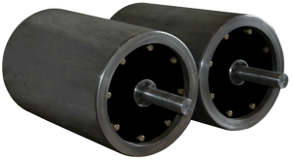
Roller Mill

Slide 5
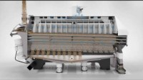
Purification System (First Step in Sifting)
The following occurs in a purifier:
removes impurities
removes smaller bran pieces
reduces coarse chunks of endosperm to fine, equally sized particles (sizings)
(referred to as semolina in this video, which is made from durum wheat)
Wheat purifier that removes impurities.
Notes:
Video: https://www.youtube.com/watch?v=JmyhXxz4OmU (2:36) Stop at 1:40.

Slide 6
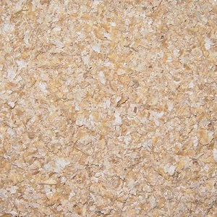

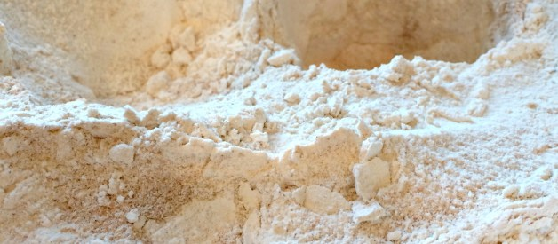
Reduction System (Sift)
The following occurs with a sifter:
reduce purified large course particles (middlings) into flour with the least amount of bran and germ contamination
Particles from this reduction system go back to the roller mill to start the grinding and sifting process over!
Purified middlings
Flour is made after the middlings have been being grinded and sifted repeatedly

Slide 7
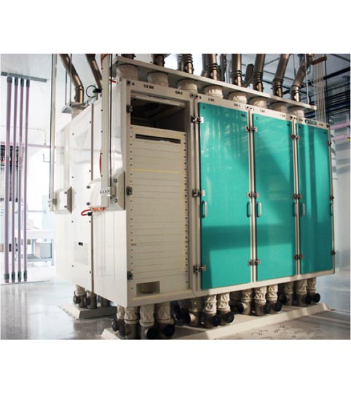
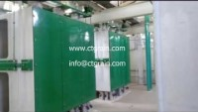
Sifter
Notes:
Video: https://www.youtube.com/watch?v=A2B_7RmpF60 (0:56) the video is loud with no commentary!

Slide 8
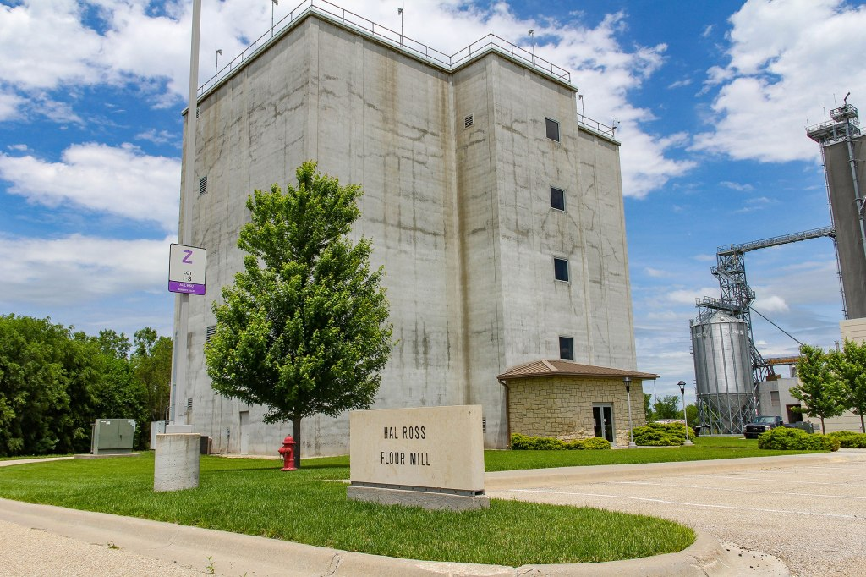
Flour Mill iVisit
Can you identify the equipment?
Notes:
https://my.matterport.com/show/?m=ignwTYmpPC7

