Slide 1
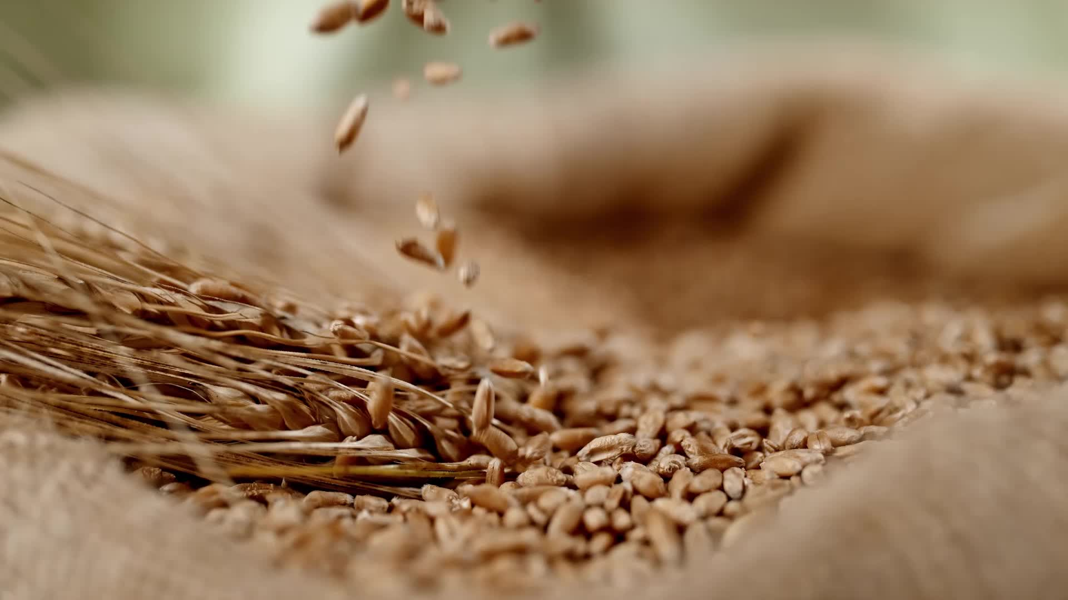
Harvest – Clean – Temper

Slide 2
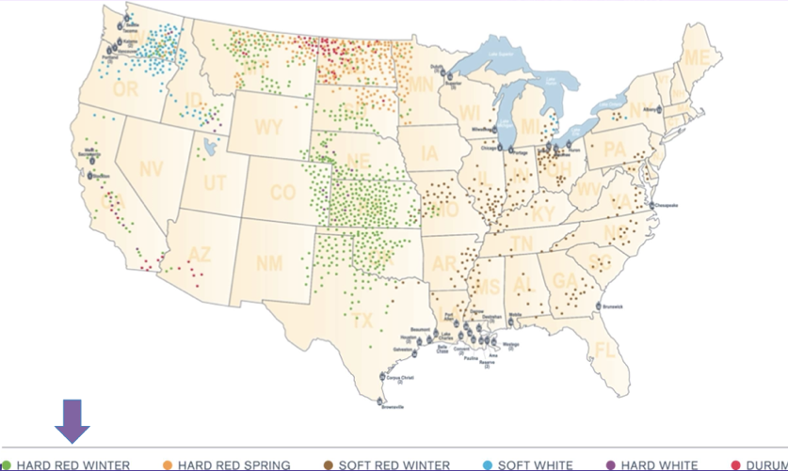
Notes:
Where varieties of wheat are grown in the United States.

Slide 3
Wheat Harvest in Kansas
Notes:
https://www.youtube.com/watch?v=wmhg1qyhvvs

Slide 4
Cleaning
What
Cleaning the wheat/seeds before milling
Why
dust control, sanitation, protect process equipment, produce quality product, remove foreign material
How
Separator: Two decks of screens - size (removes larger than and smaller than wheat)
Cylinder Separator: Two decks of screens – shape (removes weed seeds – barley, oats, soybeans, wild garlic)
Infestation Destroyer: Friability – removes insect damaged/infested kernels
Dust Control – product degradation/loss, endangerment of plant facilities and human health, worker discomfort, general housekeeping

Slide 5
Tempering
What
Tempering: time given to allow water to absorb into kernels
Adds up to 7% moisture in one temper step
Why
Mellows (softens) the endosperm
increases flour extraction
reduces power consumption and noise level of roller mills
reduces flour ash content
Toughens the bran
bran breaks up less and remains in bigger pieces
large bran flakes can effectively have flour removed without grinding the bran
How
Conditioning
Measure dry clean wheat moisture content
Measure wheat for water
Measure and add water
Mix
Temper (timing given to allow water to absorb)
Notes:
*Harder wheat = longer temp time
Extraction = taking out of something

Slide 6
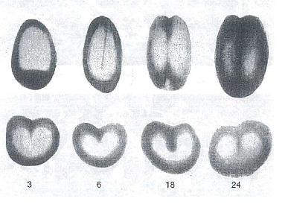
Tempering
Tempering in Action
Seeds tempering (submerged) after 3 hours, 6 hours, 18 hours, and 24 hours

Slide 7
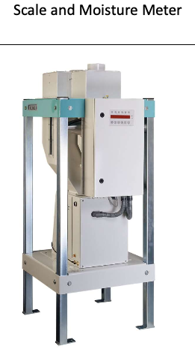
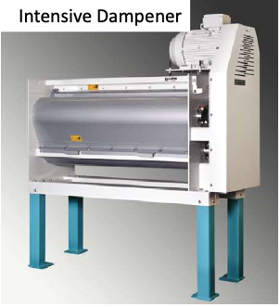
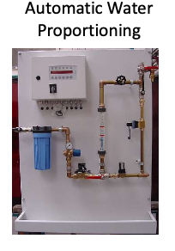
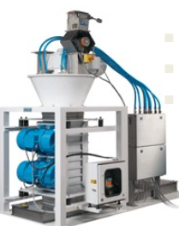
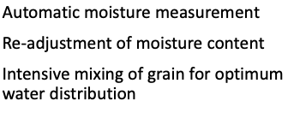

Slide 8
Impact on Temper Time
Harder wheat = longer temper time
More vitreous = longer temper time
Cold wheat = longer temper time
Cold room = longer temper time
Low starting moisture content = longer temper time
High target moisture content = longer temper time
Which classes of wheat would have longer temper times?
Notes:
*Vitreous = glassy, translucent

Slide 9
Wheat Class Temper Times
Wheat Class | Target MC | Target Temper Time
Durum Wheat | 17% | 4-6 or 24-36
Hard Red Spring | 15.5-16.5% | 12-24 hours
Hard Red Winter | 15.5-16-5% | 12-18 hours
Soft Wheat Classes | 14.5-15% | 6-8 hours

Slide 10
Tempering
Notes:
https://www.youtube.com/watch?v=WsTvZXX2ddA
The following screenshots are from the Indian Institute of Food Processing Technology: Demonstration Video on Processing of Wheat Milling - English

Slide 11
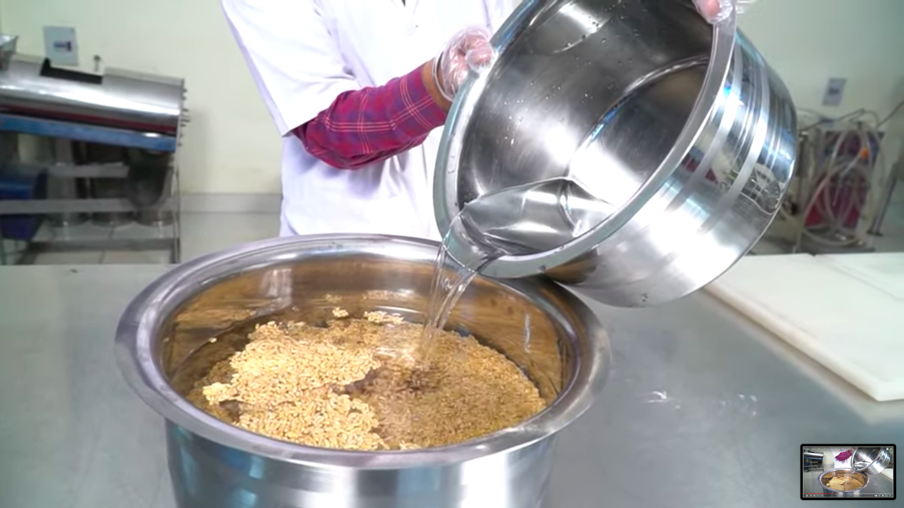
Tempering Process

Slide 12
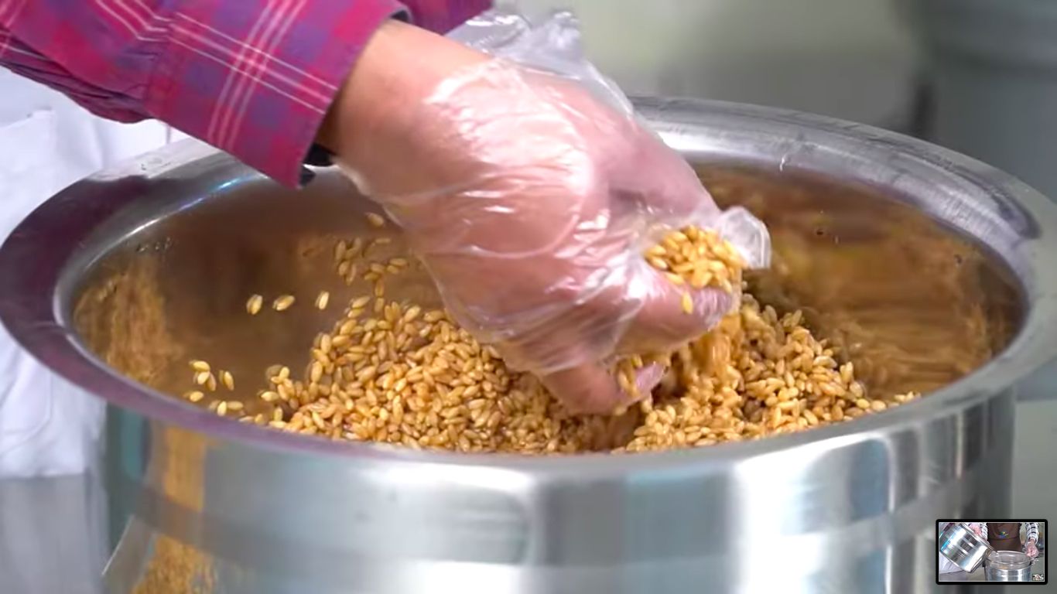
Tempering Process

Slide 13
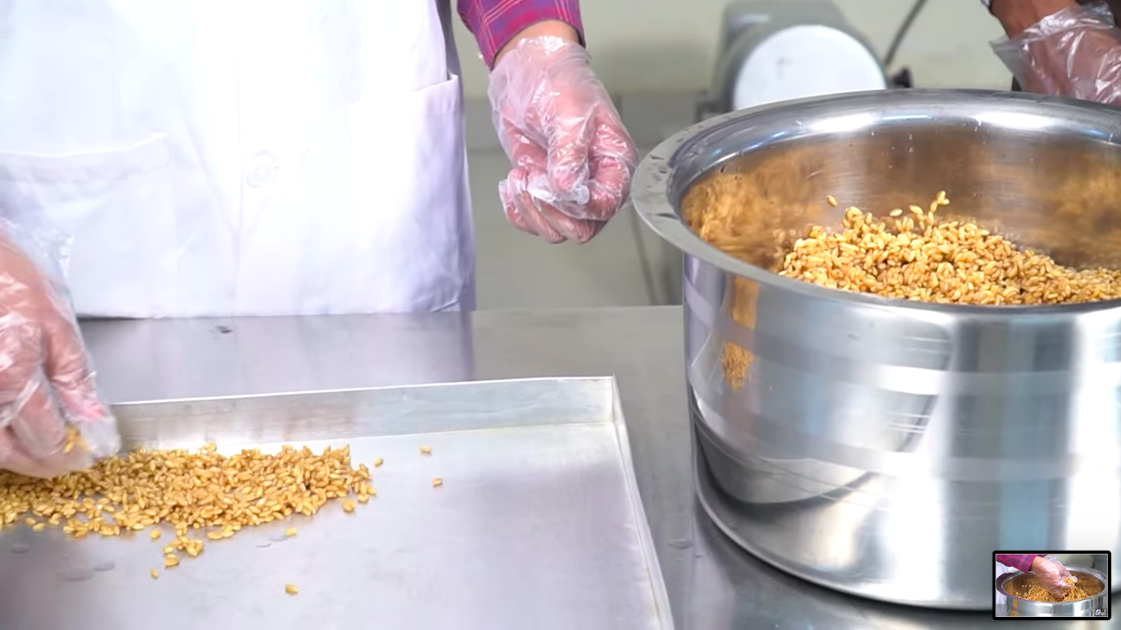
Tempering Process

Slide 14
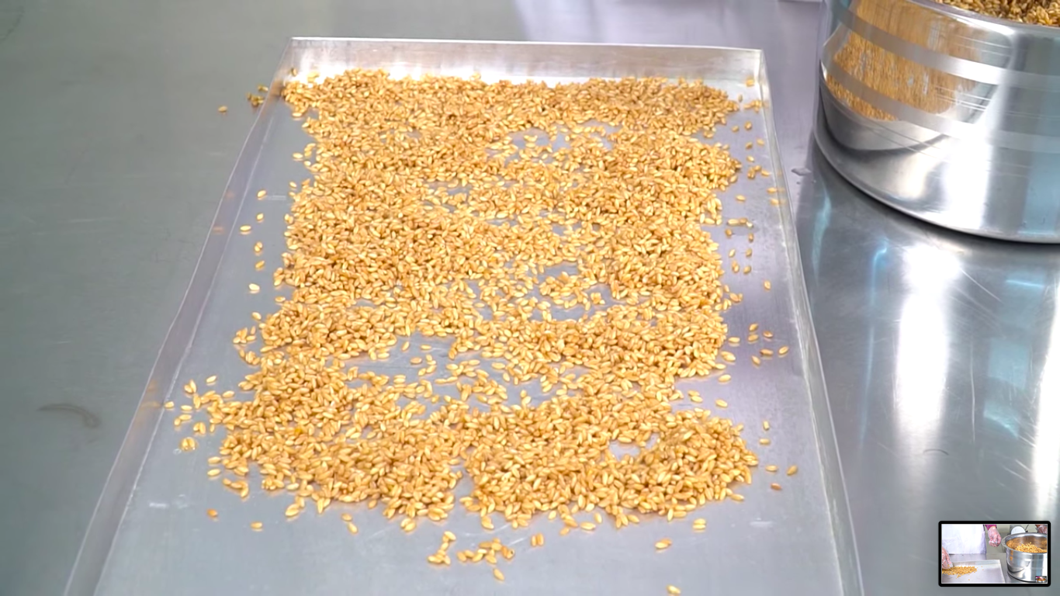
Tempering Process

Slide 15
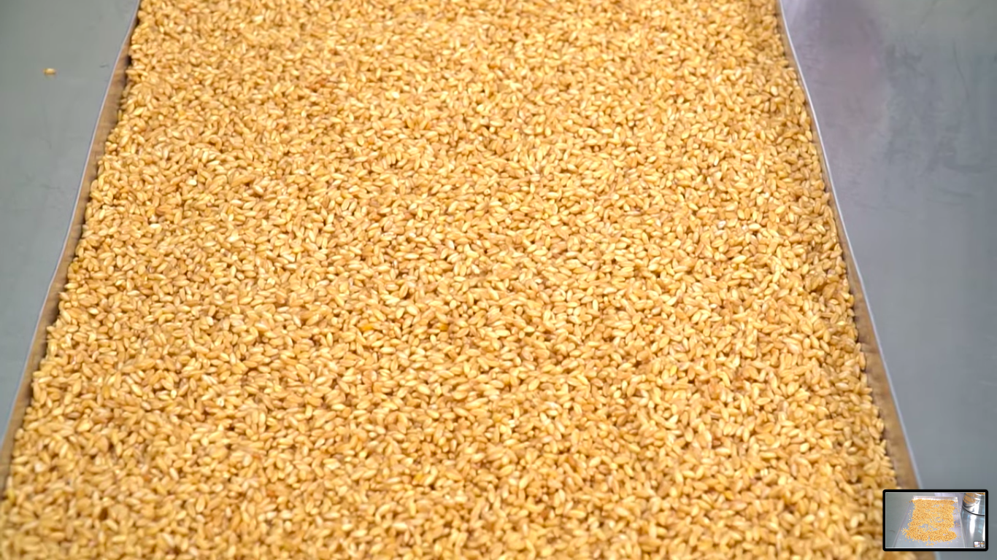
Tempering Process

Slide 16
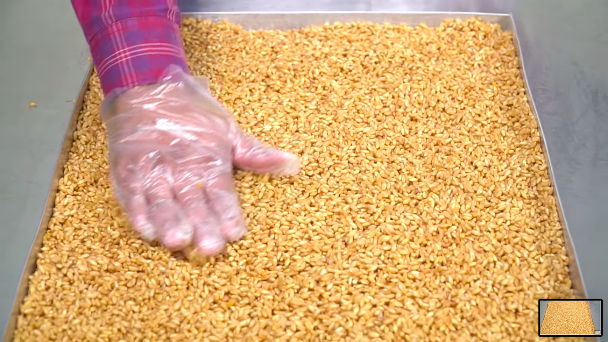
Tempering Process

Slide 17
Tempering Process

