Slide 1
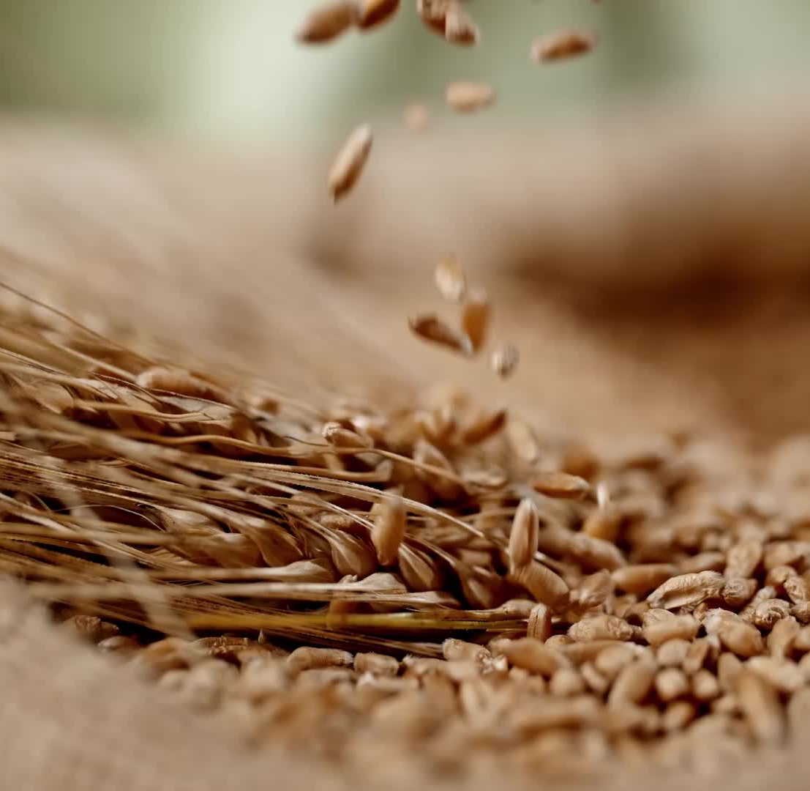
Wheat
Lesson 1

Slide 2
Classes of Wheat
Soft White
Soft Red Winter
Hard Red Winter
Hard White
Hard Red Spring
Durum
Notes:
Classes of Wheat: Slide 1-2
Present “Introduction to Wheat” slides to introduce the Six Major Classes of Wheat: Soft White, Soft Red Winter, Hard Red Winter, Hard White, Hard Red Spring, Durum
Classes of Wheat Graphic Organizer
Divide students into small groups or partners and give each group samples of wheat seeds. Give each student a Classes of Wheat Graphic Organizer. On the graphic organizer, students will record visual characteristics of each seed. Characteristics that they can record are:
Soft White: light tan grain, shorter in length and plumper than hard wheats
Soft Red Winter: prominent brush, rounded cheeks, orange color
Hard Red Winter: long, narrow kernel, narrow cheeks, dark brown color, hard vitreous
Hard White: similar to HRW but lighter in color
Hard Red Spring: reddish-brown color and bullet shaped
Durum: long kernel, humped back, amber color and translucent

Slide 3
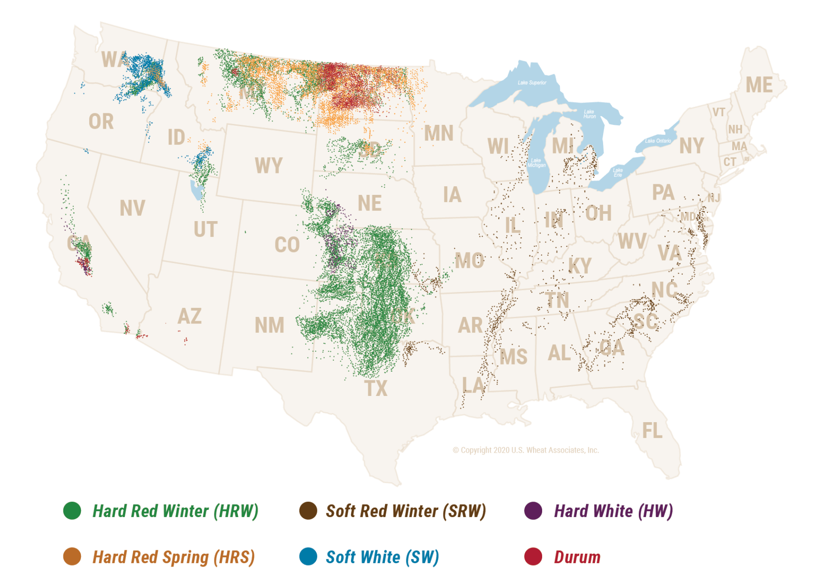
Purposes of Different Wheat Classes
Classes are designated by color, hardness and growing season.
Notes:
Present slides 2-8 to discuss each of the purposes and uses of the six classes of wheat.
On the wheat graphic organizer
Students will record notes from the slides on the Wheat Graphic Organizer.
Source: https://www.uswheat.org/working-with-buyers/wheat-classes/

Slide 4
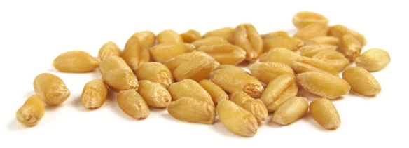
Soft White
Low protein (8.5% - 10.5%)
Low moisture (Less than 10%)
Weak gluten
Includes spring and winter varieties
Applications
Biscuits
Cakes
Cereals
Flours (cake, pastry, self-rising)
Noodles (Asian style)
Pastries
Notes:
The lower wheat moisture allows the miller to temper the wheat to a lower average target moisture optimizing flour extraction, particle size and color.
For the baker, low moisture content creates an advantage by optimizing water absorption and product quality to the consumer. The finer particle size may increase the rate of water absorption, decreasing mix time and improving production efficiencies. With the fine particle size and starch characteristics, SW flour creates a unique and tender texture for many end-products.

Slide 5
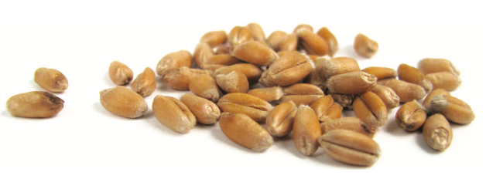
Soft Red Winter
Low protein (8.5% - 10.5%)
Soft endosperm
Red bran
Weak gluten
Applications
Pastries
Cakes
Cookies
Crackers
Pretzels
Flat breads
Blending flours
Notes:
For the miller, SRW helps diversify the types of flour produced to improve the quality of many products. SRW blended with hard red spring (HRS) and hard red winter (HRW) wheat can lower grist cost and improve bread crumb texture or improve the quality and appearance of a wide variety of products.
For the baker, the lower moisture content of the flour produced with SRW creates an advantage by increasing the added water volume while optimizing water absorption and product quality to the consumer.

Slide 6
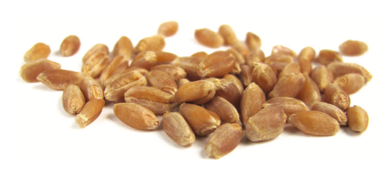
Hard Red Winter
Medium to high protein (10.0% - 13.0%)
Medium hard endosperm
Red bran
Mellow and medium gluten content
Applications
General purpose flour
Blending improver
Yeast breads and rolls
Pan breads
Cereals
Notes:
For the miller, HRW brings consistency to the grist. A balanced mill optimizes flour extraction and helps maximize milling efficiency. For the baker, HRW benefits include improved baking characteristics, including dough stability and water absorption, either alone or as part of a blend.

Slide 7
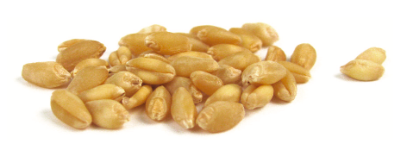
Hard White
Medium to high protein content (10.0%-14.0%)
Hard endosperm
White bran
Includes spring and winter varieties
Applications
Flat breads
Pan breads
Whole wheat
High extraction applications
Asian noodles

Slide 8
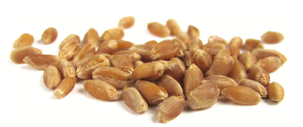
Hard Red Spring
High protein (12.0%-15.0%)
Hard endosperm
Red bran
Strong gluten
High water absorption
Applications
“Designer” wheat foods
Bagels
Artisan hearth breads
Pizza crust
Hamburger and hot dog buns
Notes:
For the miller, the reward for incorporating HRS into the grist includes a higher-than-average flour yield from its harder, more compact endosperm. For the baker, HRS delivers strong dough characteristics used alone or as part of a blend to improve the overall performance of the desired dough.

Slide 9
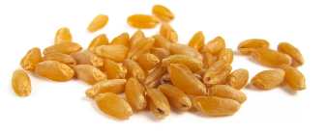
Durum
High protein content (12.0%-15.0%)
Rich amber color
Yellow endosperm
High gluten
White bran
Applications
Pasta
Semolina flour
Pizza dough
Notes:
For the miller, durum is a large, very hard kernel with the potential for very high extraction of high quality, low ash semolina that is ideal for fine pasta.

